Slide 1
Smart Network Switch
Group 9

Slide 2
Team
Mahmoud
Hardware design
Microprocessor programming
Graphic drivers
Computer networking
Mark
Hardware design
Microprocessor programming
Inferring RAM
Writing testbenches
David
Hardware design
Microprocessor programming
Design verification
Debugging with simulations

Slide 3
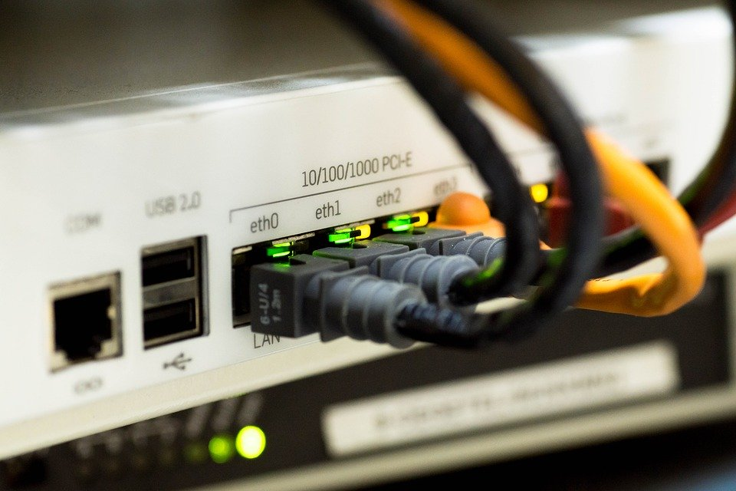
Background
Internet infrastructure: routers and switches
Forward network traffic to right target
Done by building an address-port table

Slide 4
Requirements
FPGA routes packets to the correct destination device (in hardware)
Support two devices connected across Ethernet
Support one device connected across Wi-Fi
Support IPv4
Remotely configurable
Has monitoring capabilities from a PC connected across Ethernet
Minimum Throughput: 1Mb/s

Slide 5
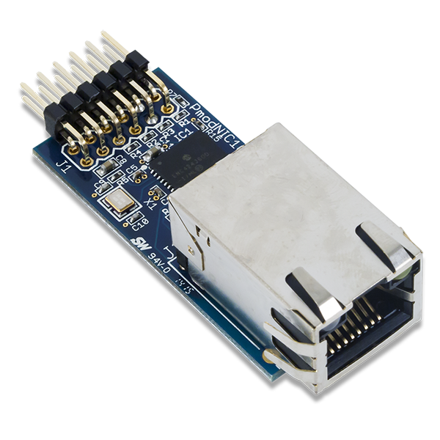
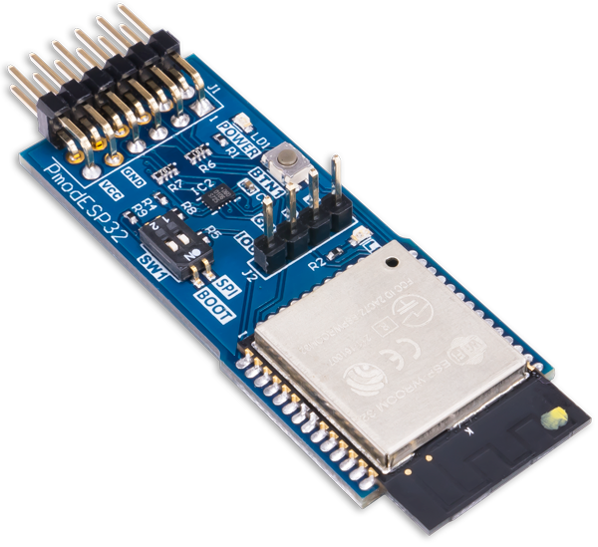
PMOD Peripheral Modules
Peripheral Modules Used:
2x NIC100: Network Interface Controller
Supports ARP
1x ESP32: Wireless Communication Module
Supports wireless access point mode

Slide 6
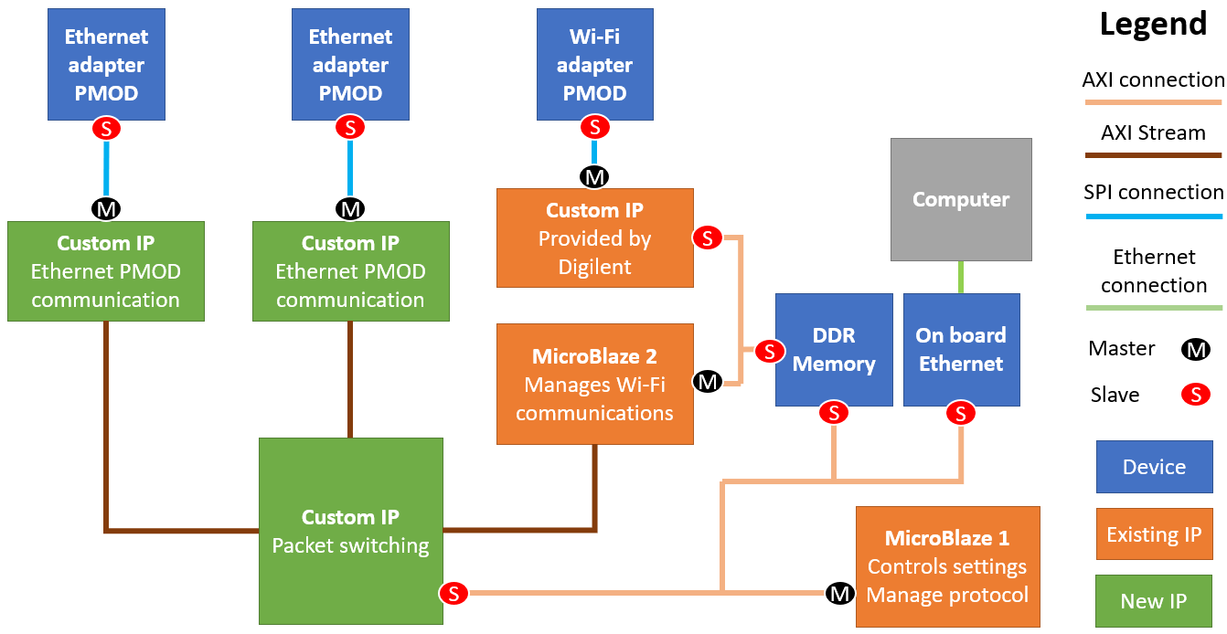
System Block Diagram

Slide 7
Testing
Wi-Fi adapter
PMOD
Wi-Fi PMOD + Microblaze 2 wireless access point
ILAs at pins of Wi-Fi PMOD and SPI interface from Microblaze to the Packet Switching IP
Wireshark on PC connected to the wireless access point
Can test the communication from Wi-Fi PMOD to the Microblaze using the demo project
S
ILA
M
Custom IP
Provided by Digilent
S
DDR Memory
MicroBlaze 2
Manages Wi-Fi communications
S
M
ILA

Slide 8
Testing
Ethernet adapter PMOD
Ethernet adapter PMOD
S
S
2x Ethernet PMODs + Ethernet PMOD Communication IP + Packet Switching IP
Simulate packets and track the data as it transitions from source input buffer to destination output buffer for Packet Switching IP
Information about packet loss and traffic related information stored in AXI slave registers for Microblaze 1
ILAs added for both interfaces of Ethernet PMOD Communication IP + Wireshark for connected devices
ILA
M
M
Custom IP
Ethernet PMOD communication
Custom IP
Ethernet PMOD communication
ILA
Custom IP
Packet switching

Slide 9
Testing
Computer
Ethernet + Microblaze 1 for configuration
The project demo already incorporates most of this functionality (minimal testing needed)
DDR Memory
On board Ethernet
S
S
MicroBlaze 1
Controls settings
Manage protocol
M

Slide 10
Milestones (up to Mid-Project Demo)
Ethernet PMOD
Look at Ethernet PMOD specs
Implement the SPI interface
Initialize the PMOD correctly
Showcase:
N/A (this will be done later on)
Wi-Fi PMOD
Look at Wifi PMOD specs
Initialize and set as access point correctly
Establish communication through sending commands
Showcase:
Communication with a remote device
Packet Switching IP
Create design plan
Implement in Verilog
Develop testbench
Verify and debug functionality using simulation
Showcase:
Switching of packets

Slide 11
Milestones (up to Final Demo)
Ethernet PMOD (cont.)
Establish communication through sending commands
Remote Access
Program Microblaze to receive and interpret messages
Add capability of enabling/disabling ports in the Packet Switching IP
System Integration
Integrate Wi-fi PMODs with Packet Switching IP
Integrate Ethernet PMODs with Packet Switching IP
Final integration and system-level debugging
Final Demo: Everything working! (ideally…)

Slide 12
Risks
Unable to establish Ethernet PMOD communications
Mitigation: Work with the PMODs early on to identify issues quicker
Backup Plan: Use Bluetooth PMODs
All components/IPs may not fit on the Nexys DDR Board
Mitigation: Can customize Microblaze to remove features, saving space
Backup Plan: Limit the number of PMODs used in the network switch

Slide 13
ANY QUESTIONS?

